Slide 1

Scénarios contrastés d’évolution des élevages en Europe
L’approche du projet PATHWAYS
Pierre-Marie Aubert, Directeur, Politiques agricoles et alimentaires, Iddri
Journée d’étude MAEL, 13 mars 2025

Slide 2
Introduction and messages clés
L’élevage, au cœur de la durabilité du système alimentaire…
… et en même temps objet de vives tensions, controverses, débats
… et de prise de position souvent très « tranchées »… mais partiales !
La nécessité d’une conversation apaisée pour trouver des voies de sortie
  Reconnaître l’intrication des enjeux (sociaux, éco, env, culturels…) en se donnant une représentation la plus juste possible du système alimentaire
  Les scénarios dans PATHWAYS : prendre au sérieux les revendications des uns et des autres à avoir « la » solution… et la tester jusqu’au bout
  … pour identifier compromis et synergies dans une approche située de la transition

Slide 3
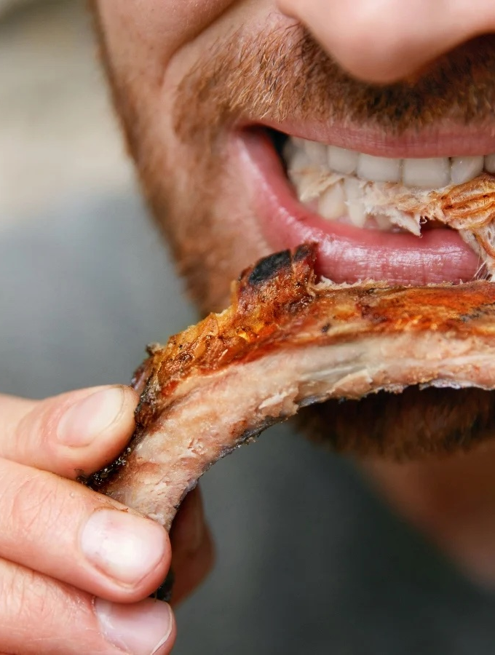
Des enjeux éminemment intriqués

Slide 4
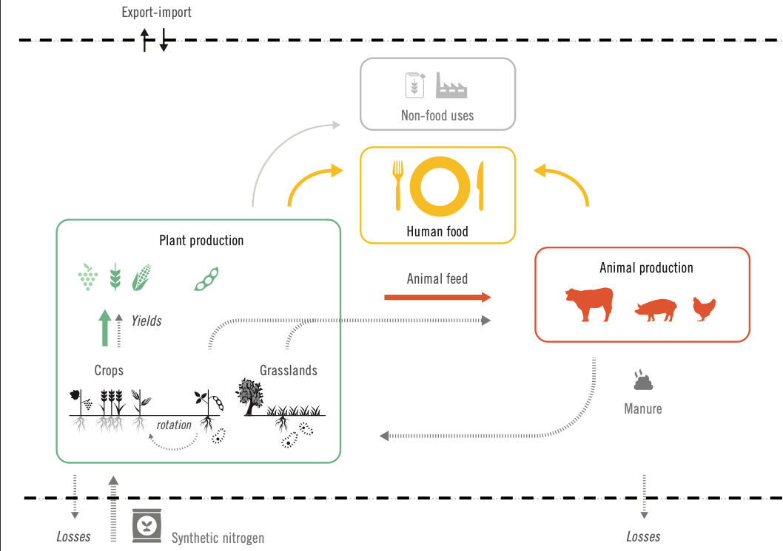
Une représentation du système alimentaire

Slide 5
Une représentation du système alimentaire

Slide 6
Une représentation du système alimentaire

Slide 7
Une représentation du système alimentaire

Slide 8
Une représentation du système alimentaire

Slide 9
Une représentation du système alimentaire

Slide 10
L’importance de l’élevage dans les flux de biomasse et d’azote

Slide 11
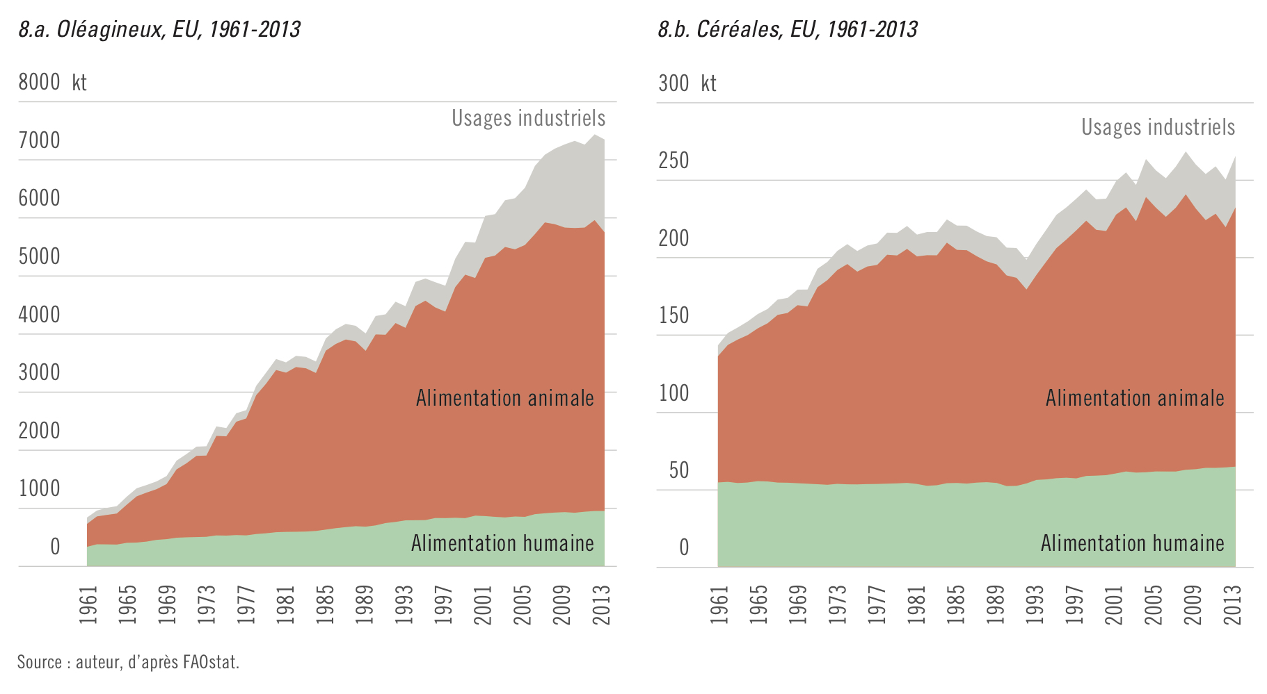
L’importance de l’élevage dans les flux de biomasse et d’azote

Slide 12
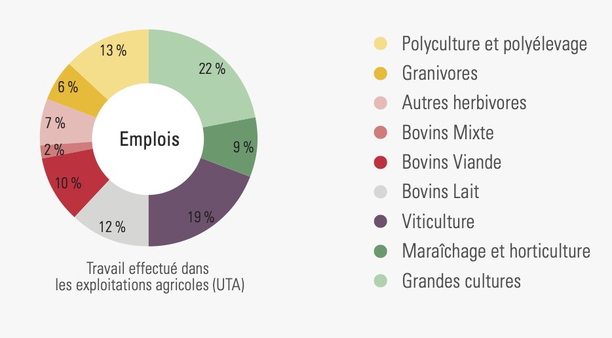
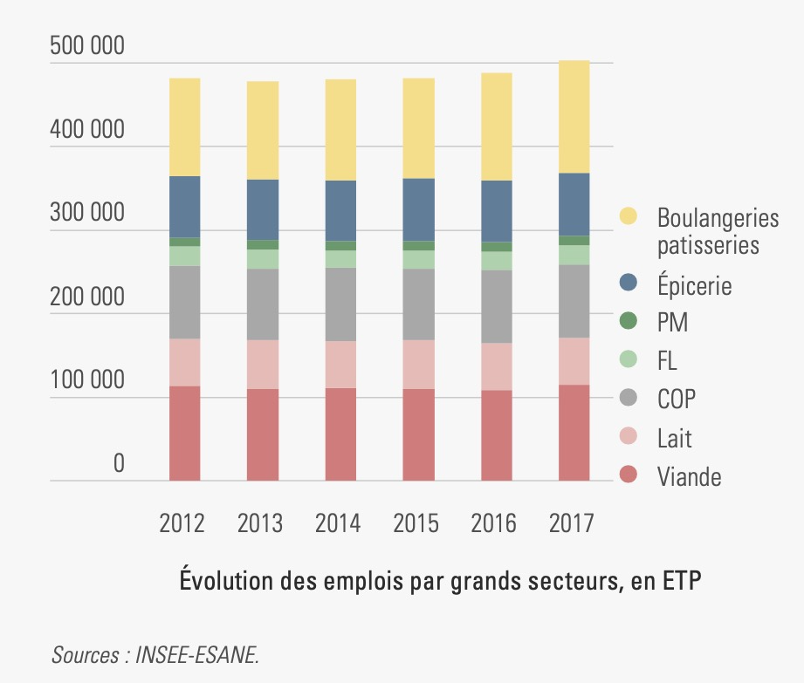
… dans les équilibres socio-économiques

Slide 13
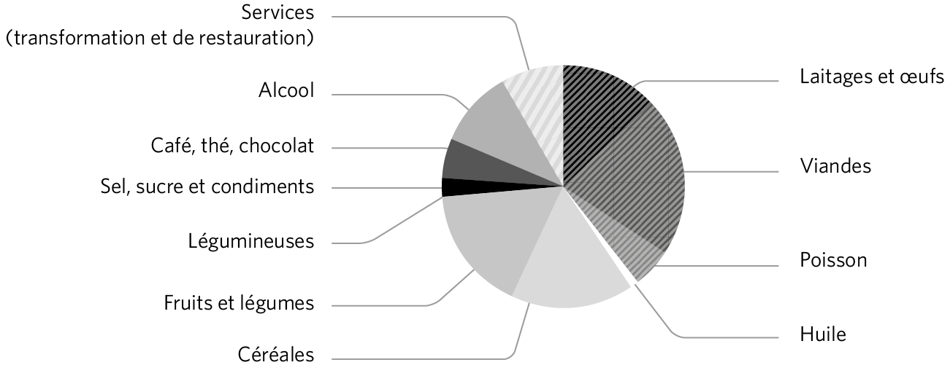
… et les pratiques alimentaires
Prise protéique des européens, 1962-2013
Budget alimentaire des français, 2019

Slide 14
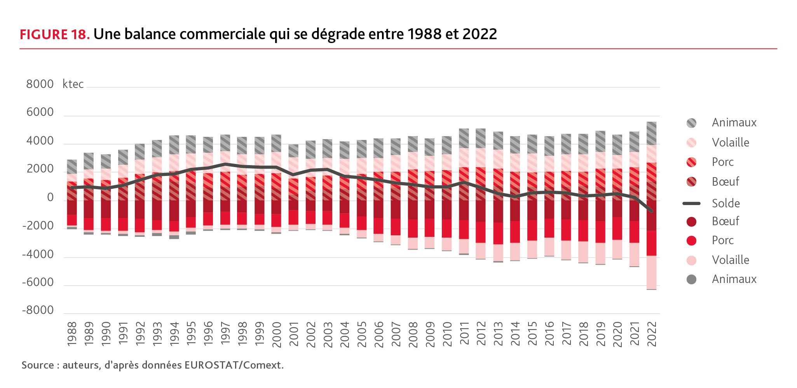
Dans un contexte économique qui se durcit pour les éleveurs français

Slide 15
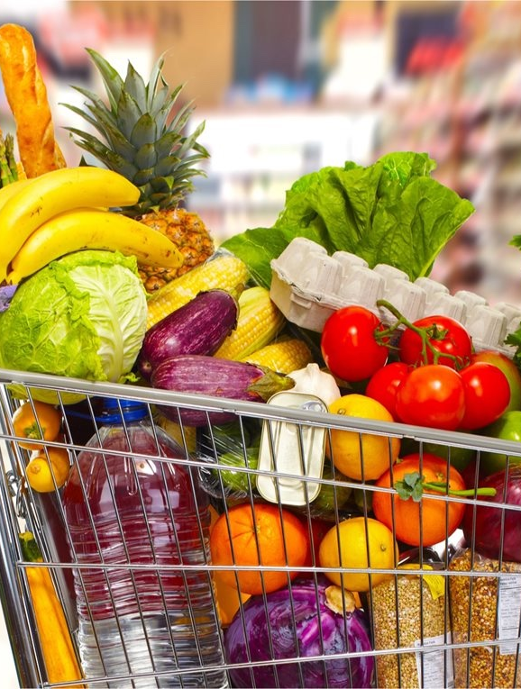
Les scénarios du projet PATHWAYS

Slide 16
Des scénarios pour explorer et discuter
Objectifs du projet PATHWAYS : identifier des leviers politiques et économiques pour une transition vers un élevage plus durable
Des scenarios pour explorer une diversité d’options, évaluer les trade-offs et les synergies entre ces options…
… et développer des trajectoires de transition, technico-économique et socio-politique

Slide 17
4. “Backcast” from the 2050 pictures to 2020 to create transition pathways (Sept 2025-June 2026)
Storyline#1
Scenario A: EU livestock sector in 2050
Storyline#2
2. Identify trade offs and synergies through assessment / modelling (Oct 2023-March 2025)
Scenario B
EU livestock sector 2020 (=baseline)
Storyline#3
Scenario C
Storyline#4
1. Develop a set of storylines that cover the whole “transition space” (June 2022-Sept 2023)
Storyline#5
3. Recombine the storylines to minimize trade offs and synergies (Dec 2024-Setp 2025)

Slide 18
Le statut des récits présentés
Une manière de raconter une transformation de l’élevage en « suivant » une logique, un principe de base
« qu’est ce qui se passerait si le secteur de l’élevage évoluait selon la logique / le principe X ? » – sans présager du caractère désirable ou faisable de ce futur possible
Peu d’attention – jusque là – aux conditions de leur déploiement
Quant aux impacts : leur évaluation est en cours !

Slide 19
The “founding principles” of the five storylines
Feed no food: feed-food competition is reduced to its minimum, while agrobiodiversity conservation is integrated into agricultural practices
Efficiency first: the focus is on increased feed conversion efficiency of animal productions as a key lever to reach environmental performance. The search for efficiency extends beyond th livestock systems, to the processing industry, that transitions following a strong “industrial ecology” approach
Rural renaissance: livestock sector transformations contribute to revitalize rural communities through the maintenance of a strong agricultural dynamics across landscapes, a greater level of autonomy for farmers that deliver not only food but also a range of ecosystem services, through more local systems.
High animal welfare: the objective is to maximize the positive experience of animals throughout the value chains, and to increase animals agency over their own lives, e.g., by providing interesting indoor and outdoor spaces or robotic milking, which encourages individual choice.
A stockfree Europe: the progressive disappearance of production-oriented livestock systems across Europe, and with it of the industrial production capacity at all stages

Slide 20
Feed no food
Livestock systems: ruminants are fed a 100% forage diet (permanent grassland + ley) in adaptive systems (more or less intensive depending on the context), under the assumption of maintaining the area under permanent grassland across Europe. Monogastrics are fed on food waste and by product.
Landscape: reintroduction of ruminants in arable dominated areas for fertility transfer and ley management. The land previously cropped for feed serve increasingly for legumes, fruits and vegetables for human consumption, but also for tree planting, cereal export or biofuel production
Transport: transport time for ruminants might increase to reach the different grazing sites
Processing industry: the likely decrease in volumes leads to restructuration of the facilities and a decrease in their number (both dairy and meat) + increase in shorter supply chains
Retail: promote a shift to plant-based diets, while offering imported monogastric proteins alongside certified high-quality ruminant products
Trade: trade of human-edible feed ceases entirely, yet the import of animal proteins increases slightly as consumption patterns do not change significantly enough to compensate the decrease in production

Slide 21
Efficiency first
Livestock systems: strong increase in feed conversion efficiency through the use of technology (precision feeding, etc), but systems are still highly dependent on external inputs. The share of animals kept indoor to increase their efficiency greatly increases, with an expansion in monogastric production and a decrease in ruminant systems (especially suckler cows). Farm concentration also continues.
Landscape: regional concentration continues, with a growing disconnection between animal and vegetal production.
Processing industry: the concentration of the industry continues to enable economies of scale and industrial ecology approaches, with greater standardisation and automation of processes
Transport: transport time would be reduced due to the continued specialization & concentration processes
Retail: concentration continues.
Trade: exports of livestock products would increase, while increased intra-European trade would support maintaining self-sufficiency at the European level

Slide 22
Rural renaissance
Founding principle: livestock sector transformations contribute to revitalize rural communities
Livestock systems: diversification and extensification of farms & livestock systems to increase the range of ecosystem services rendered to society at the level of each farm.
  2/3 of small / medium farms, moderate to high labour intensity (incl. on farm processing), close to town
  1/3 of large farms that produce raw products, with a high degree of automation
Landscape: More heterogeneous landscapes, thanks to the co-existence of diverse farms and the use of land sharing techniques to increase the provision of ecosystem services.
Processing industry: partial relocalization of the industry through collaboration between farmers and local SMEs + slight increase in on-farm processing. Large facilities remain to process raw material produced in large farms.
Transport: transport of live animals and unprocessed material decreases
Retail: the role of traditional retail decreases. Local forms of food distribution (e.g., direct off-farm sales, delivery hubs, farmer markets, farmer shops, home delivery) gain in importance and local retail cooperatives organise diverse retail
Trade: International trade outside of Europe is reduced, with a greater focus being given on supplying domestic European markets.

Slide 23
High animal welfare
Founding principle: livestock sector transformations contribute to increase positive experiences for animals
Livestock systems: become overall less intensive, with animals being granted access to outdoor (=> ∆– in stocking density) and feed that reflects natural and diverse diets, while social structures will be respected as much as possible. Increase use of monitoring techniques will enable farmers to react to health related issues. Monogastrics likely to be hit harder than ruminants by such changes.
Landscape: Such changes in livestock system would lead to more diverse landscapes and a ∆– in stocking density.
Transport: will be reduced due to a reduced specialisation of farms and regions and a relative decentralisation of abattoirs reducing distances and time in transit. Remaining transport will be improved to align with the Welfare Quality® principles
Processing industry: a relative geographical de-concentration is expected that results in more, medium-sized abattoirs and dairies as well as an increase in mobile abattoirs and on-farm slaughter providers – but number of companies might ∆+. Restructuring of slaughter for pigs and poultry to more humane method
Retail: the role of traditional retail decreases. Local forms of food distribution (e.g., direct off-farm sales, delivery hubs, farmer markets, farmer shops, home delivery) gain in importance and local retail cooperatives organise diverse retail
Trade: low levels of trade of animals and animal products due to the protection of the European market against lower-standard imports. It is assumed that the restructuring of livestock systems in this way will have consequences for cropping systems, too

Slide 24
A stock-free Europe
Founding principle: the progressive disappearance of any type of livestock across Europe.
Livestock systems: will either undergo a complete shift in their production orientation or cease to operate.
Landscape: available cropland will be used to satisfy European demands for human edible arable and horticultural & permanent crops, with an increased use of legumes and intercropping, which is accompanied by energy crops on the remaining arable land. All grasslands will be either rewilded or afforested (with a proportion still to determine).
Transport: Live animal transport ceases, and the focus of transport is on bulky products with high shelf lives.
Processing industry: parts of the meat & dairy industry would get involved in the production of alternative proteins (fermentative proteins, lab-grown meat, traditional pulses, plant based meat alternatives, insects) and high value vegetable processing. This is however only accessible to the larger processors, as SMEs are unlikely to be able to make this transition while remaining competitive.
Retail: promotes meat and dairy alternatives
Trade: Imports of livestock products are expected to increase (also depending on assumptions on consumption) in this storyline, while the export of arable and horticultural crops, as well as by-products that are currently fed to livestock, will is set to increase

Slide 25
Les axes d’évaluation
Macro-économique = MAGNET
Micro-économique (niveau ferme) = SPCalc
Agro-environnemental = GeoSOL
Storylines
Micro-économique (niveau industrie) = IAACalc
Sociologique (niveau consommateur) = TRAME

Slide 26
La logique d’évaluation : une approche multidimensionnelle, quanti et quali

Slide 27
Prochaines étapes
Niveau UE : modélisation MAGNET et Sol disponibles fin 2025
Niveau France: un rapport prévu pour juin 2025
Des échanges constants avec les acteurs économiques et politiques !
  La stratégie « élevage durable » de la Commission Européenne
  La question d’une tarification carbone pour l’agriculture
  La vision des 100 jours de Hansen
  Quid de l’industrial deal ?

Slide 28

Merci pour votre attention !
This project has received funding from the European Union’s Horizon 2020 Research and Innovation Programme under grant agreement No 101000395.
Pierremarie.aubert@sciencespo.fr
https://www.linkedin.com/in/pierremarieaubert/

