Slide 1
Practice hub 4
Anna Hessle
070324

Slide 2
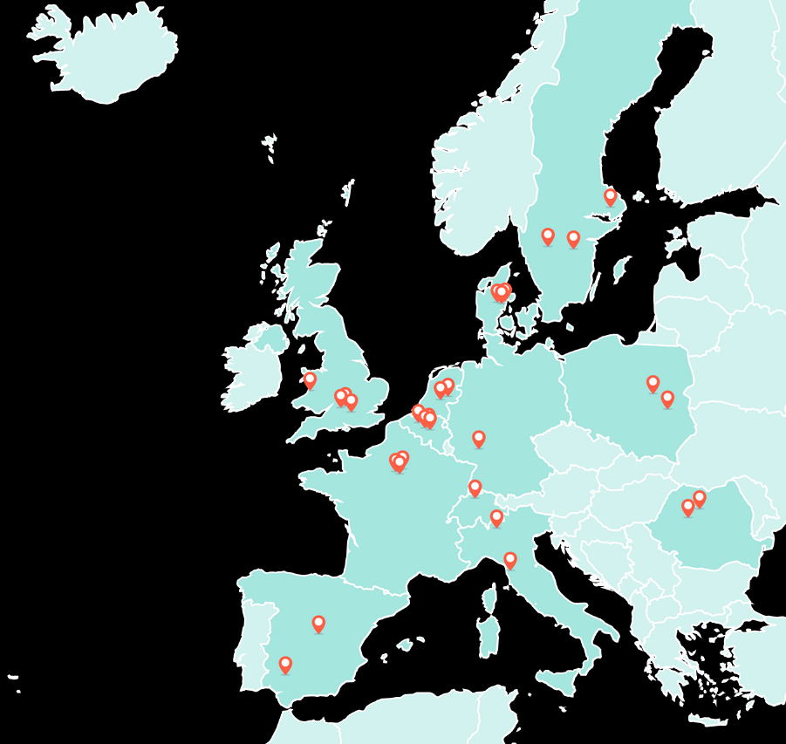
Introduction
SWEDEN
More-from-less dairy systems utilising on-farm advice and carbon foot-printing tool
Dairy cows

Slide 3
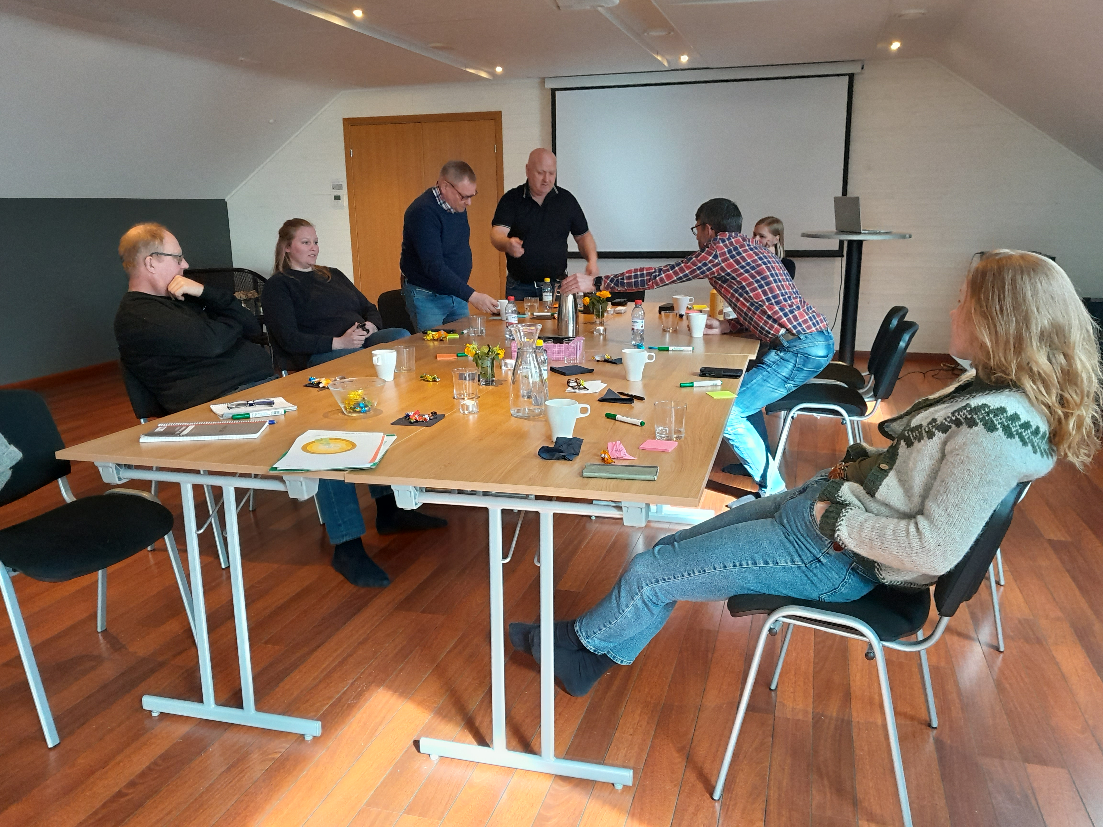
Innovation
OECD Area of Innovation: Marketing
System type: Intensive, mainstream
Innovation interests: Consumers view on environmental sustainability and animal welfare based on fact, starting with the consumers of tomorrow

Slide 4
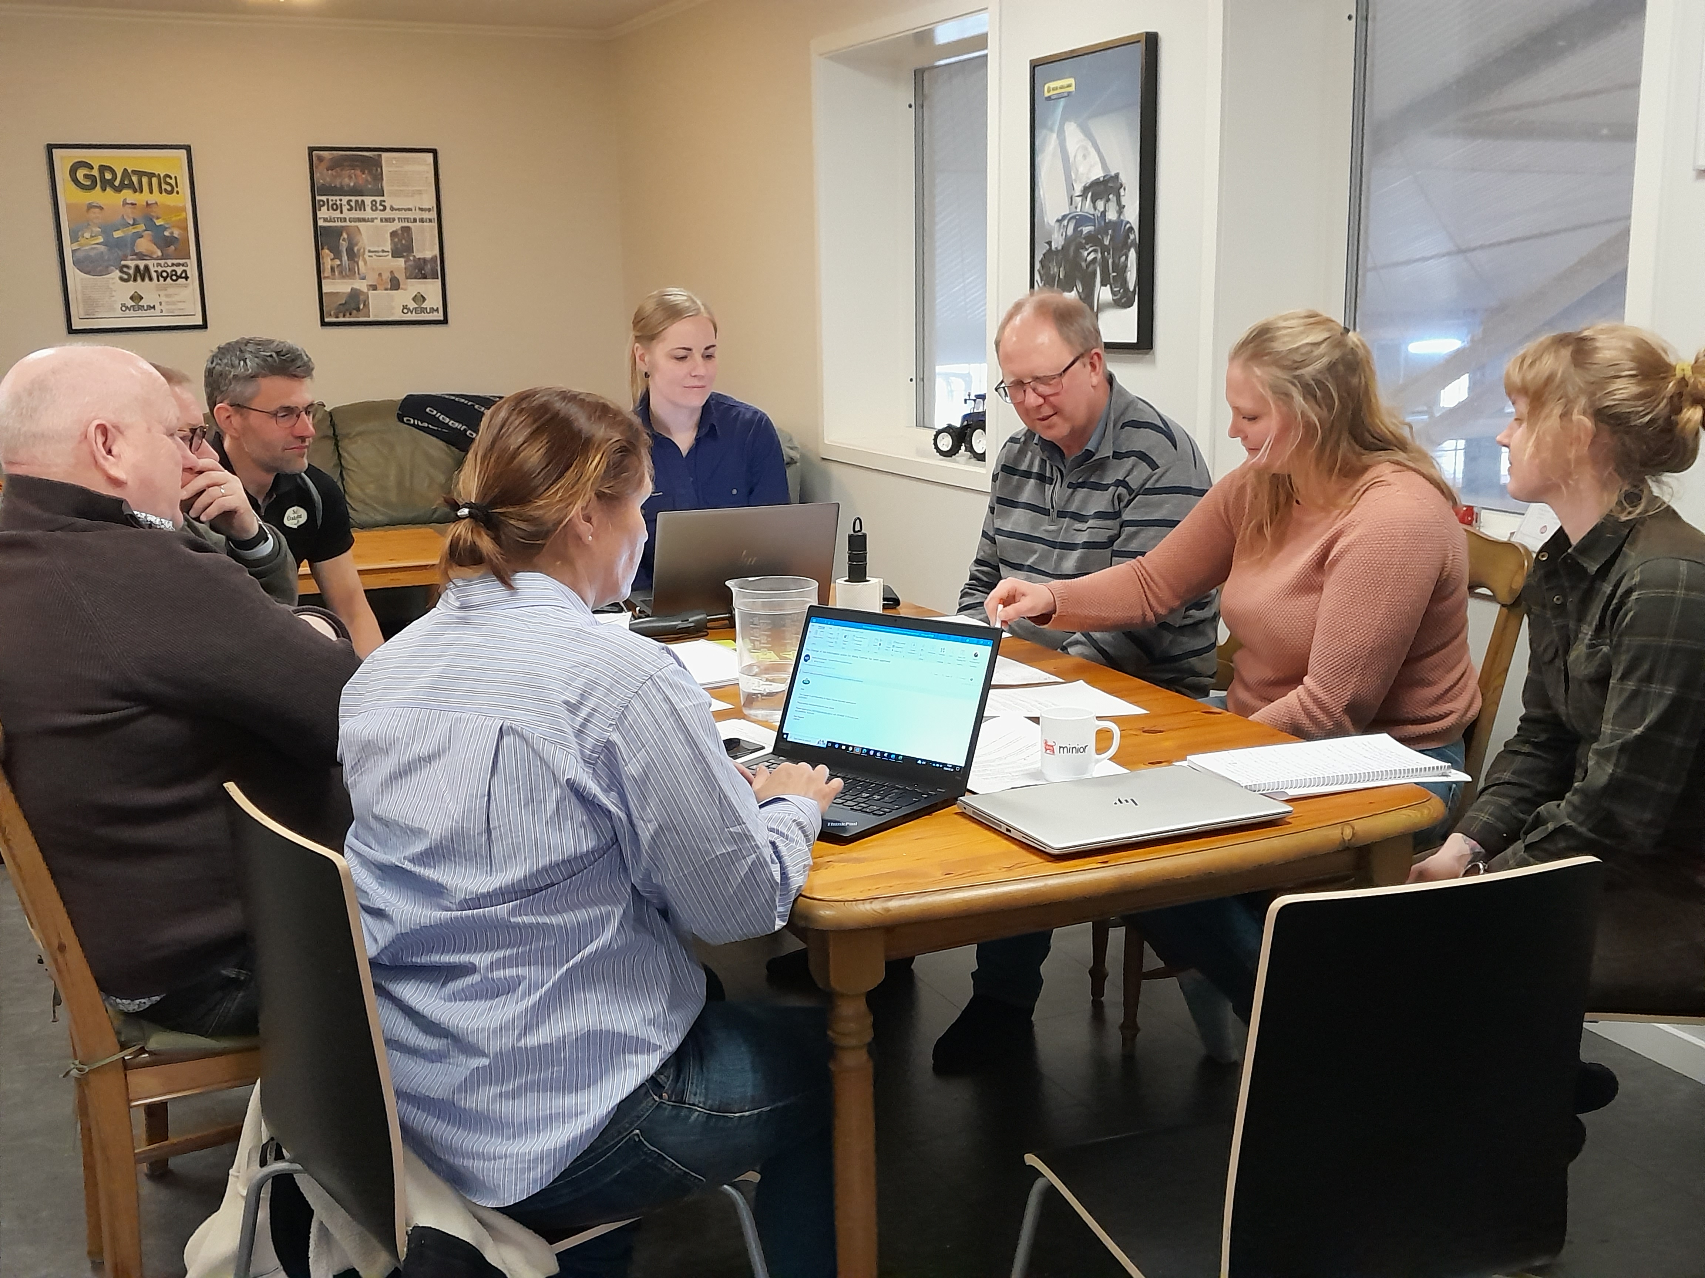
Challenges
Background for the innovation is a challenge: The general public’s preconceived (and not seldom skew) view on environmental sustainability and animal welfare in livestock production of today
Bureaucracy is for sure a challenge; long time for decision within Pathways including a modification of the idea and regarding human-ethic permission.

Slide 5
Uniqueness
In the LL process, we started to discuss measurements of environmental performance and animal welfare in the hub farms and compare the results with averages. There was however no such data available.
Instead, we agreed on focusing on bringing fact about modern dairy farming to children and pre-school teachers as the ongoing discourse is perceived by the farmers as not being based on fact.
Several of the farmers in the hub already participating in a lot of public events, not the least for children, but they miss updated written material to hand out at these occasions.

Slide 6
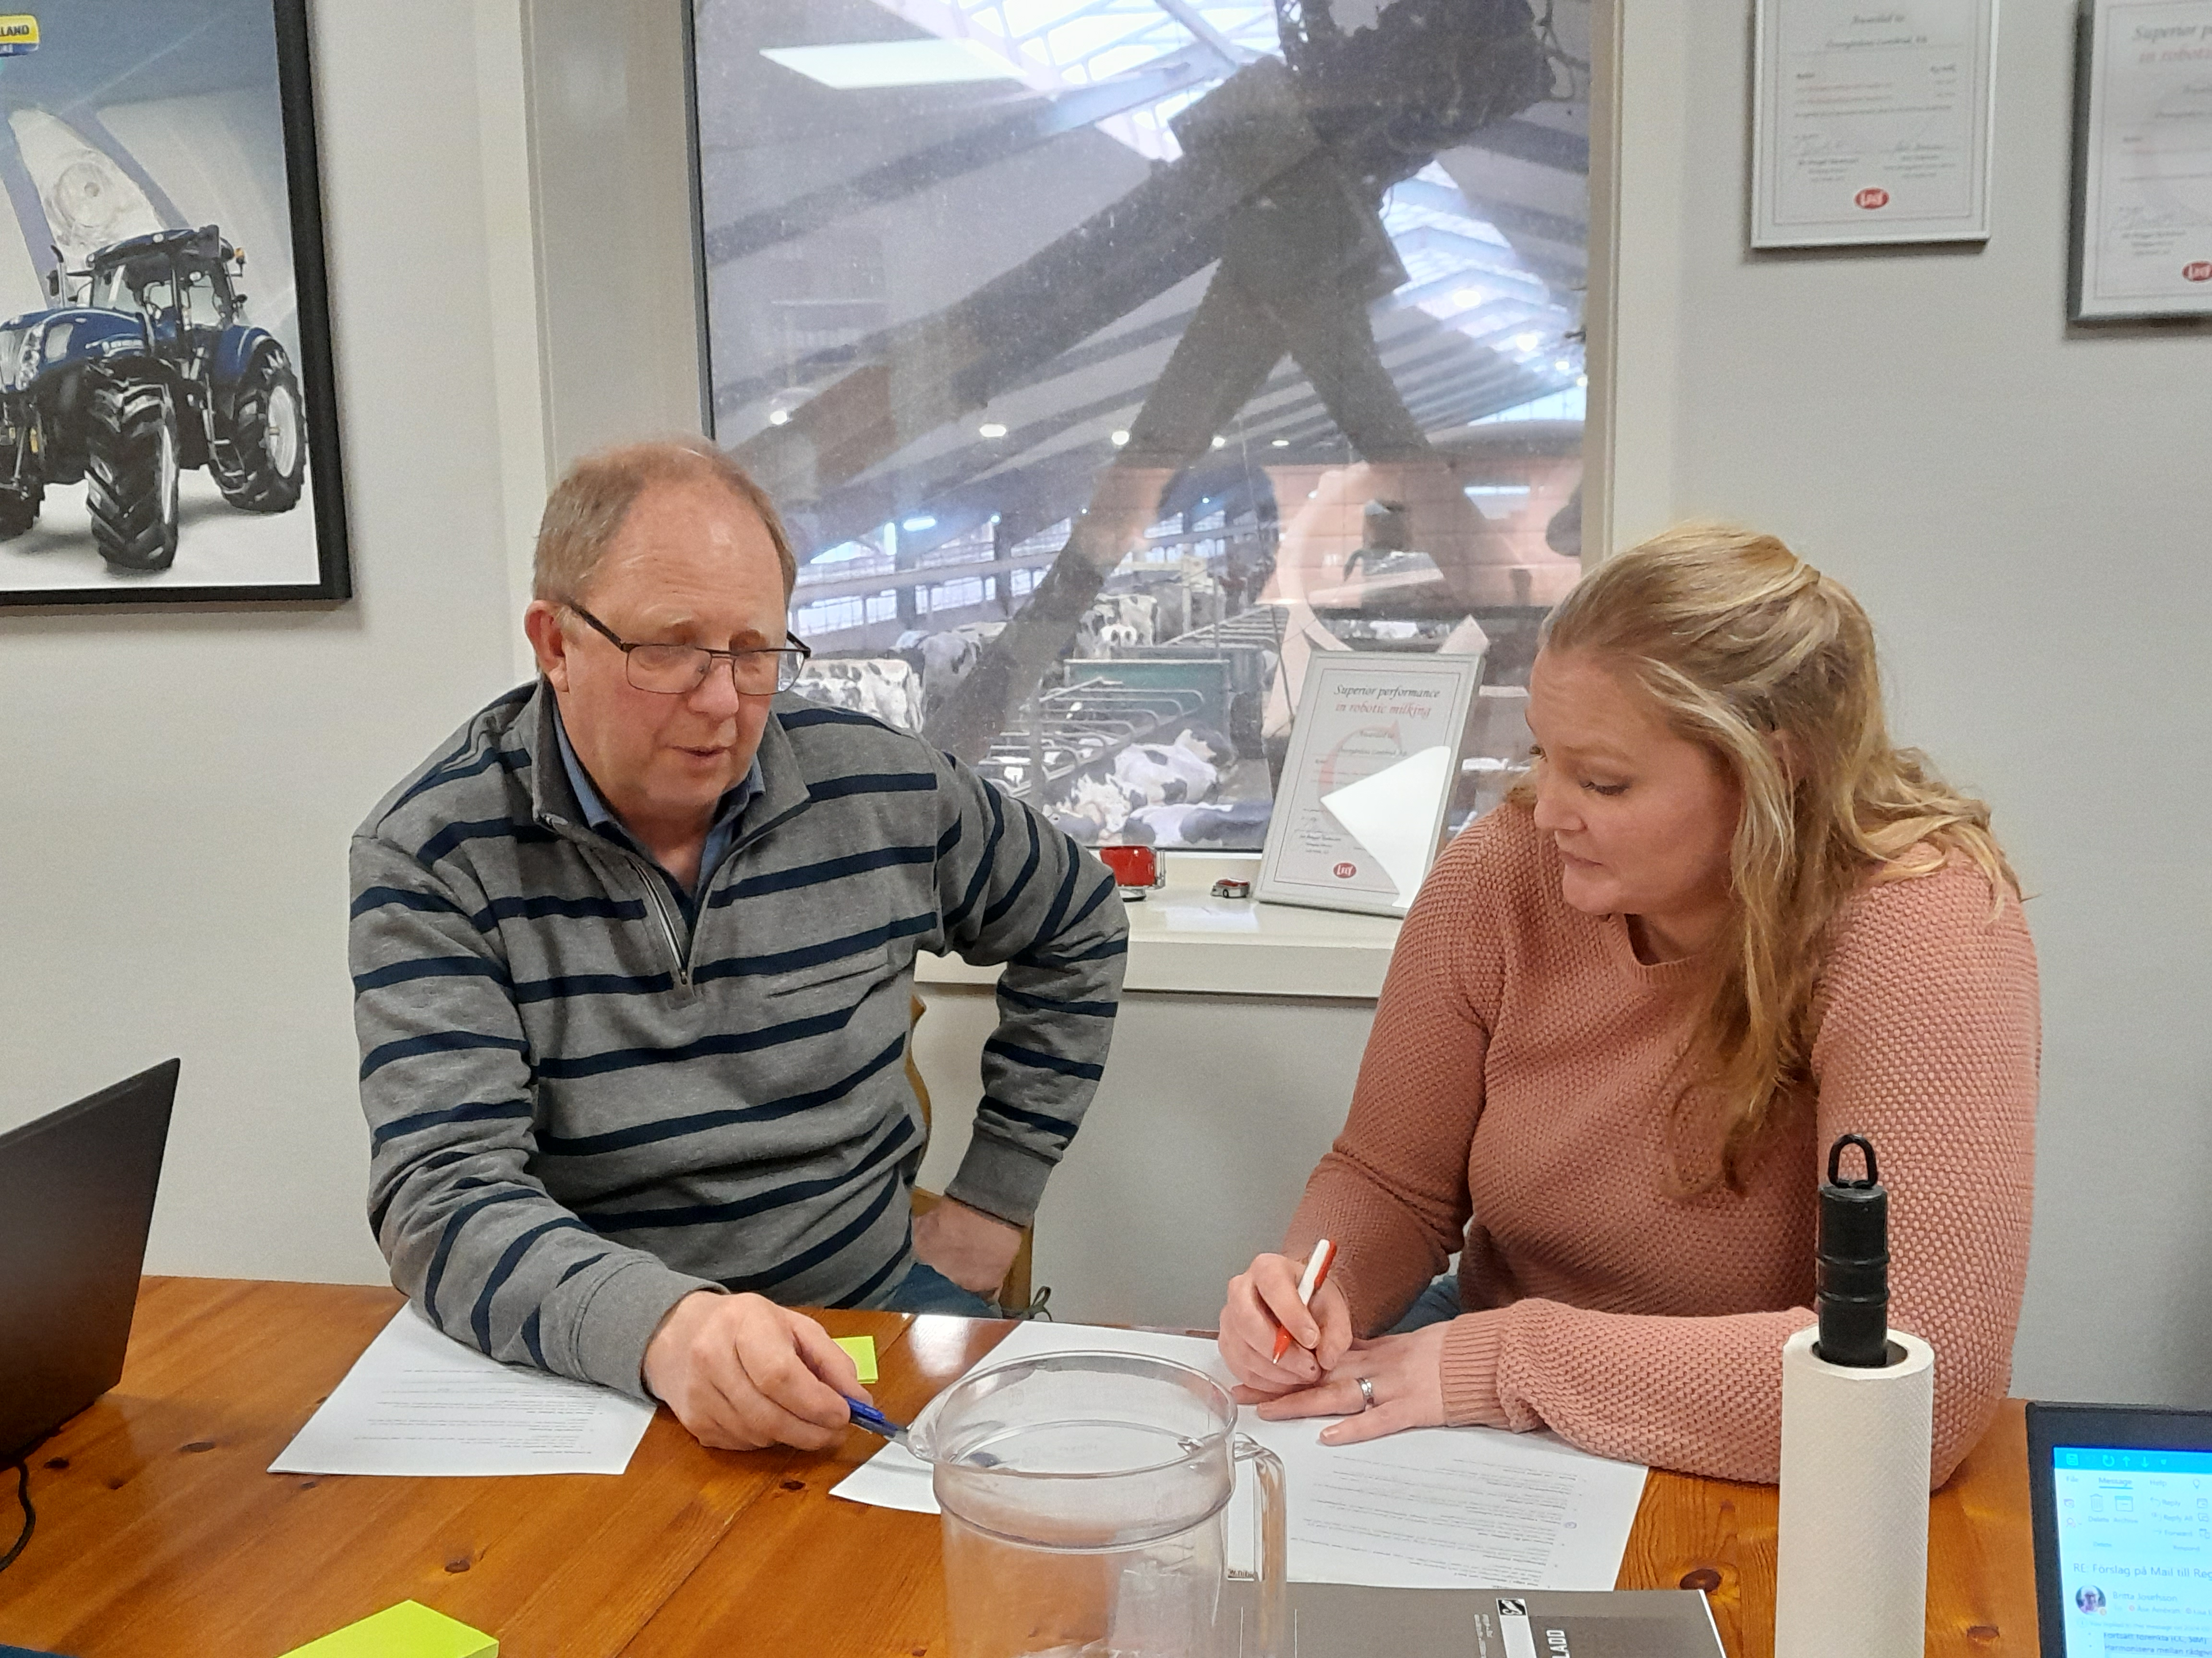
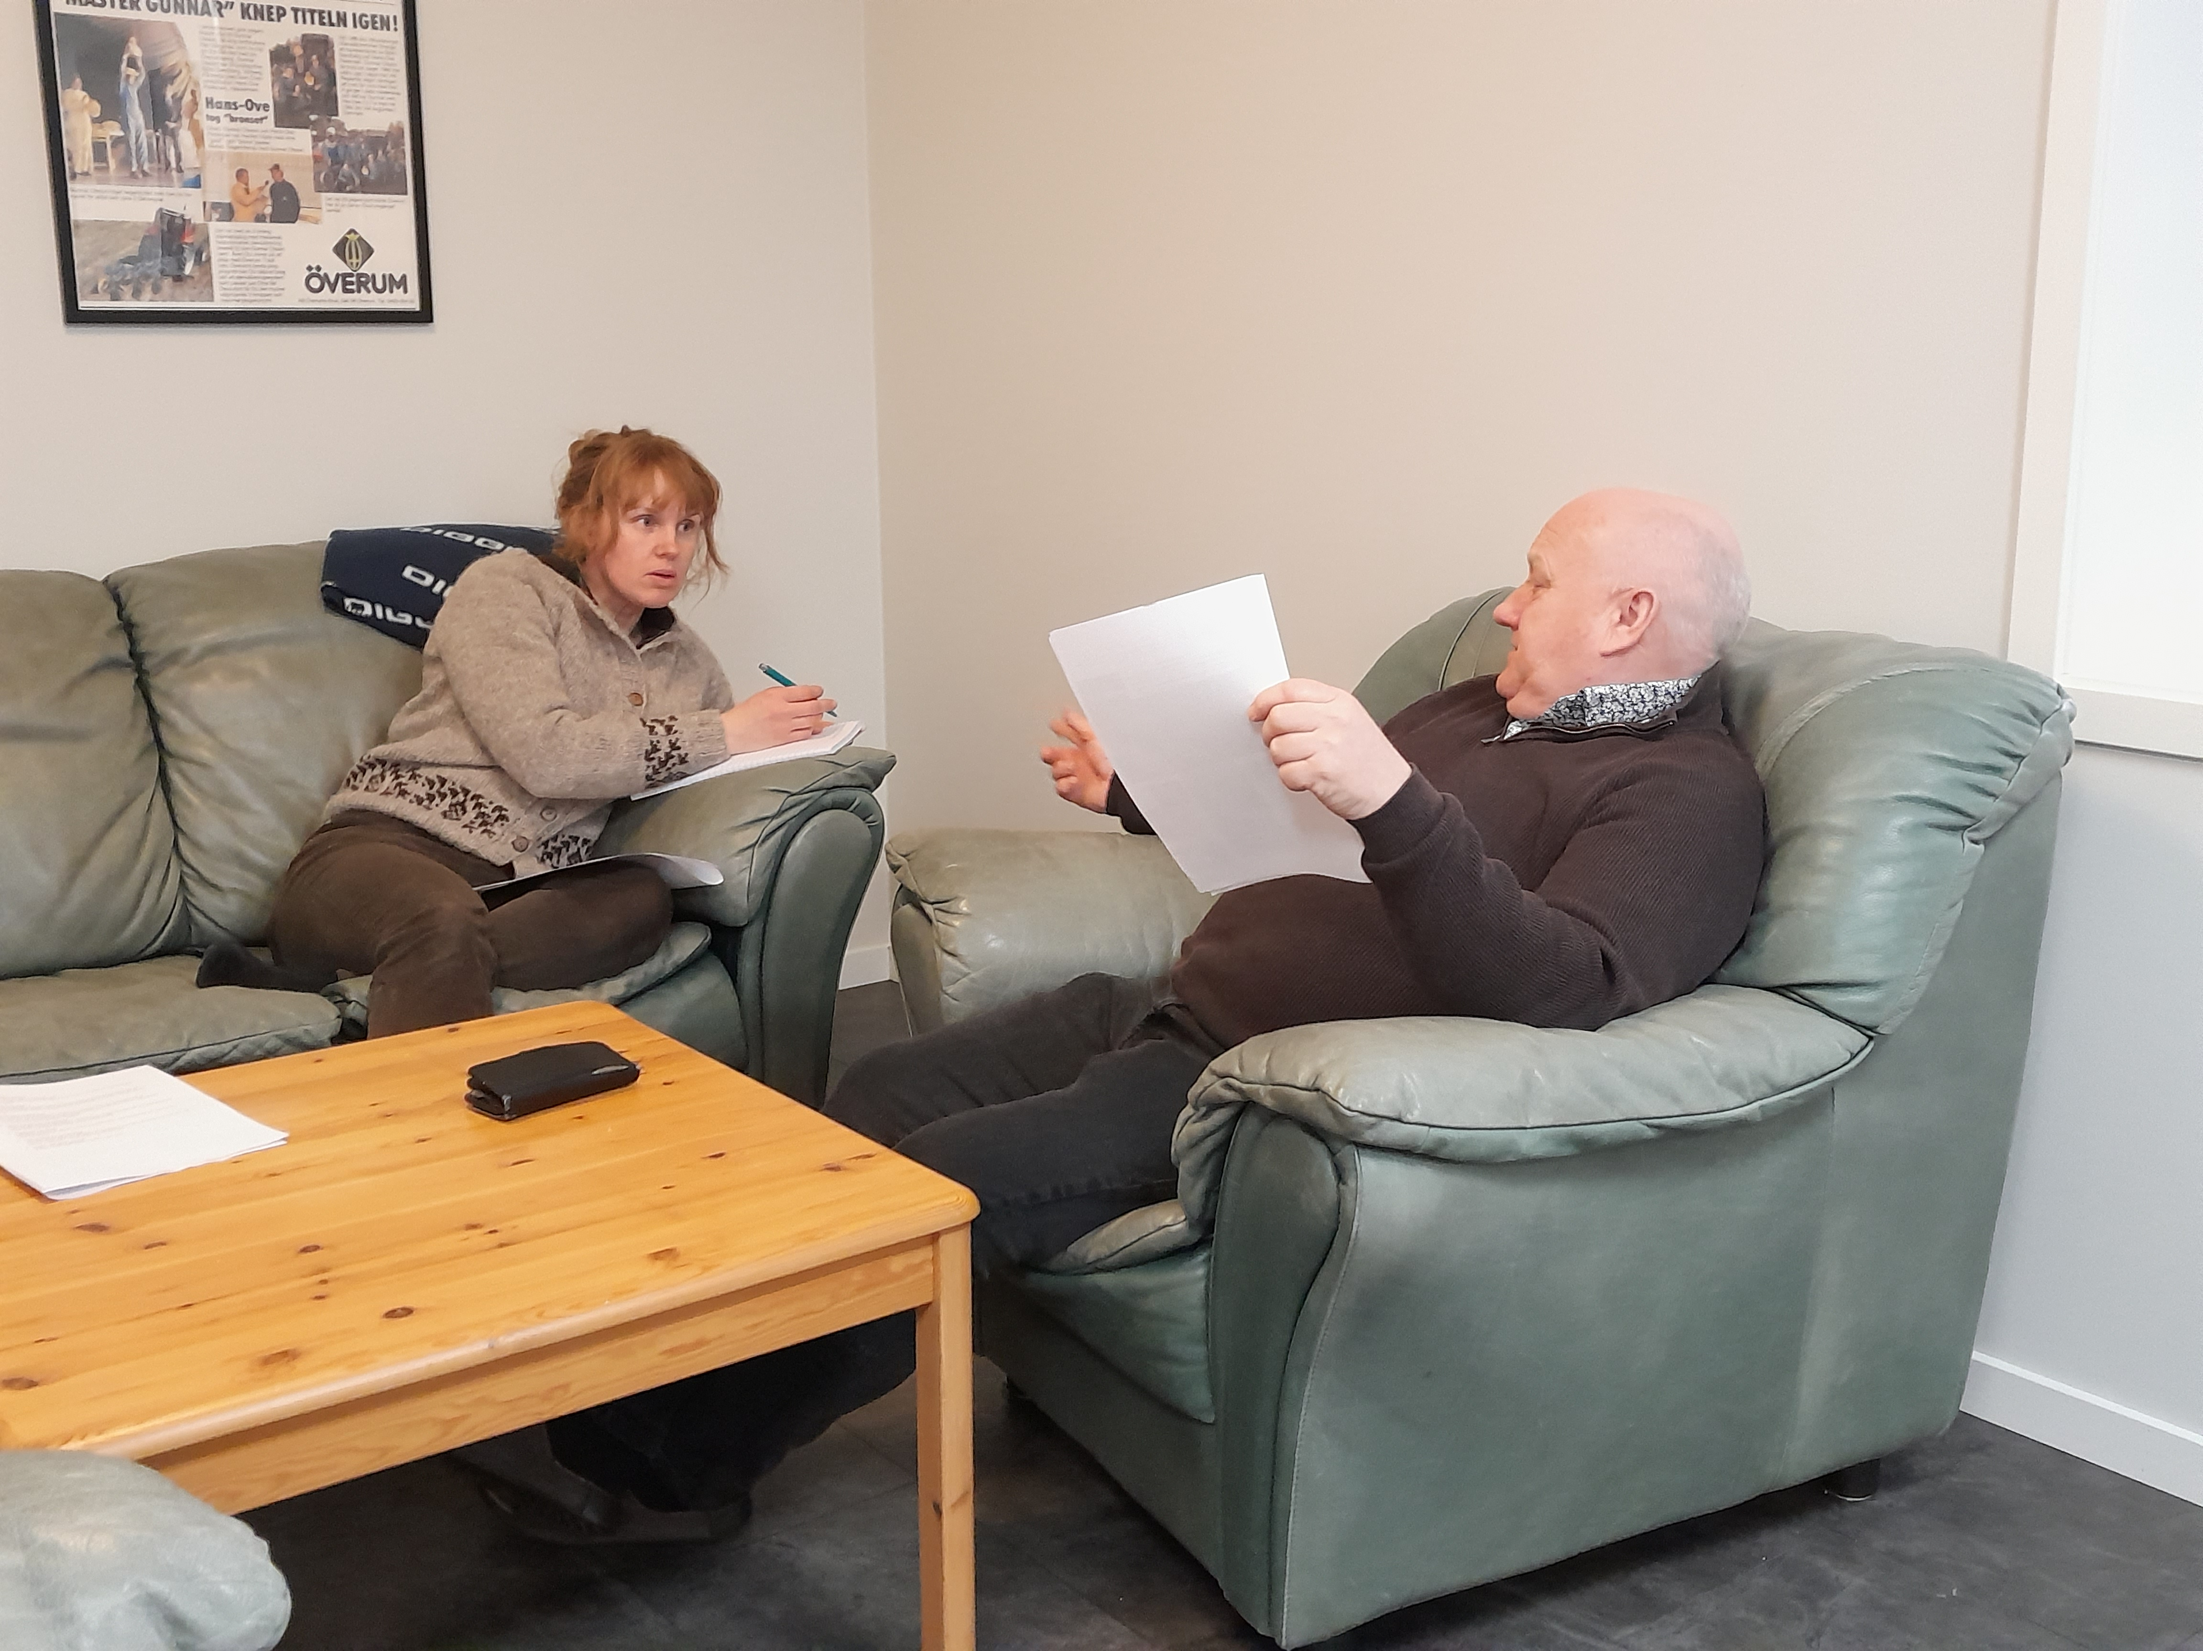
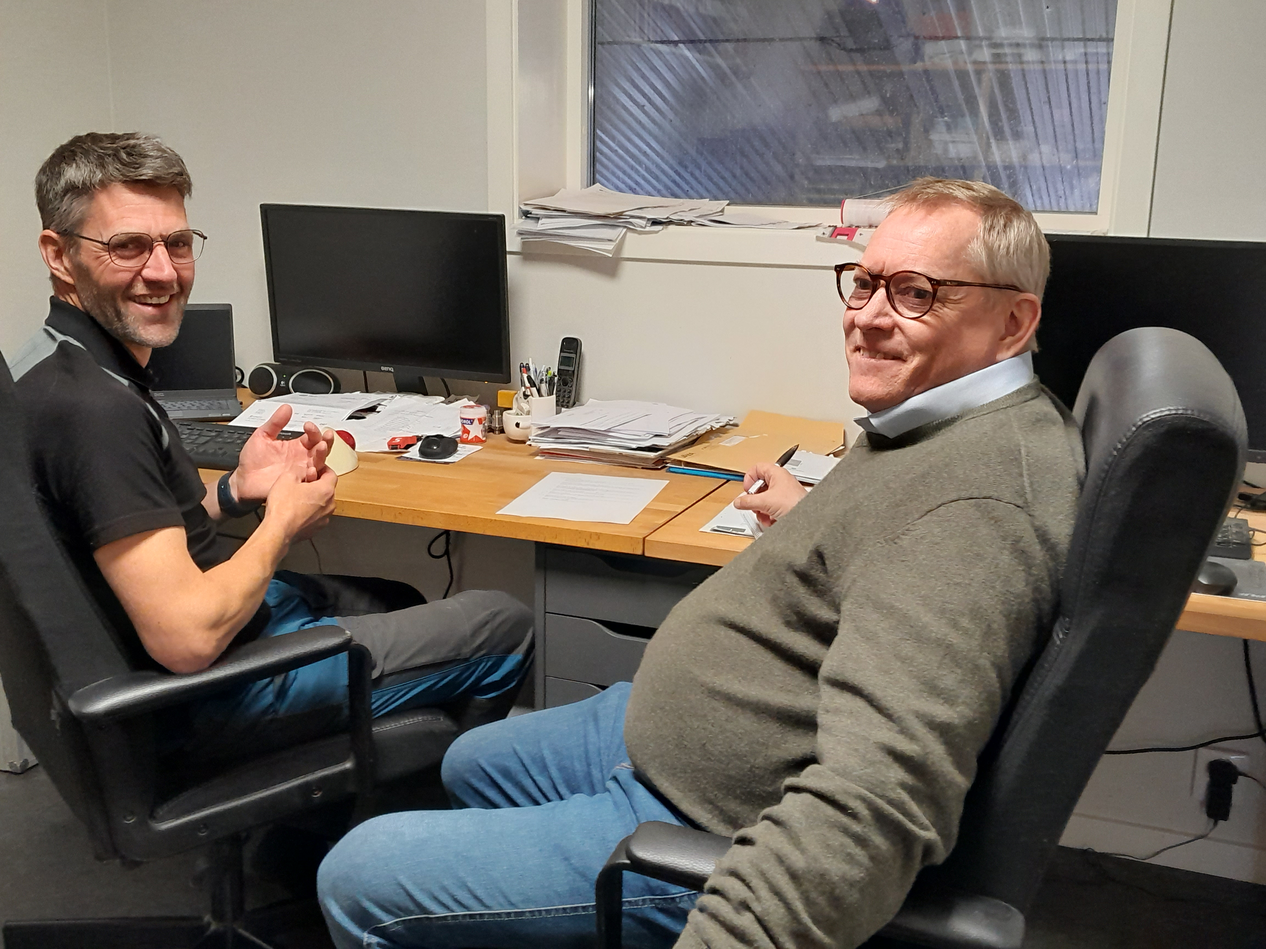
The now and the future
A small working group was established, which created a “gross list”.
The whole hub met on Feb 22, 2024, and decided on content and format A5, 16 pages.
Sara will put together the input and send to the communicator who will transform it to a draft.
Sara is also making av video of the LL work.

