Slide 1
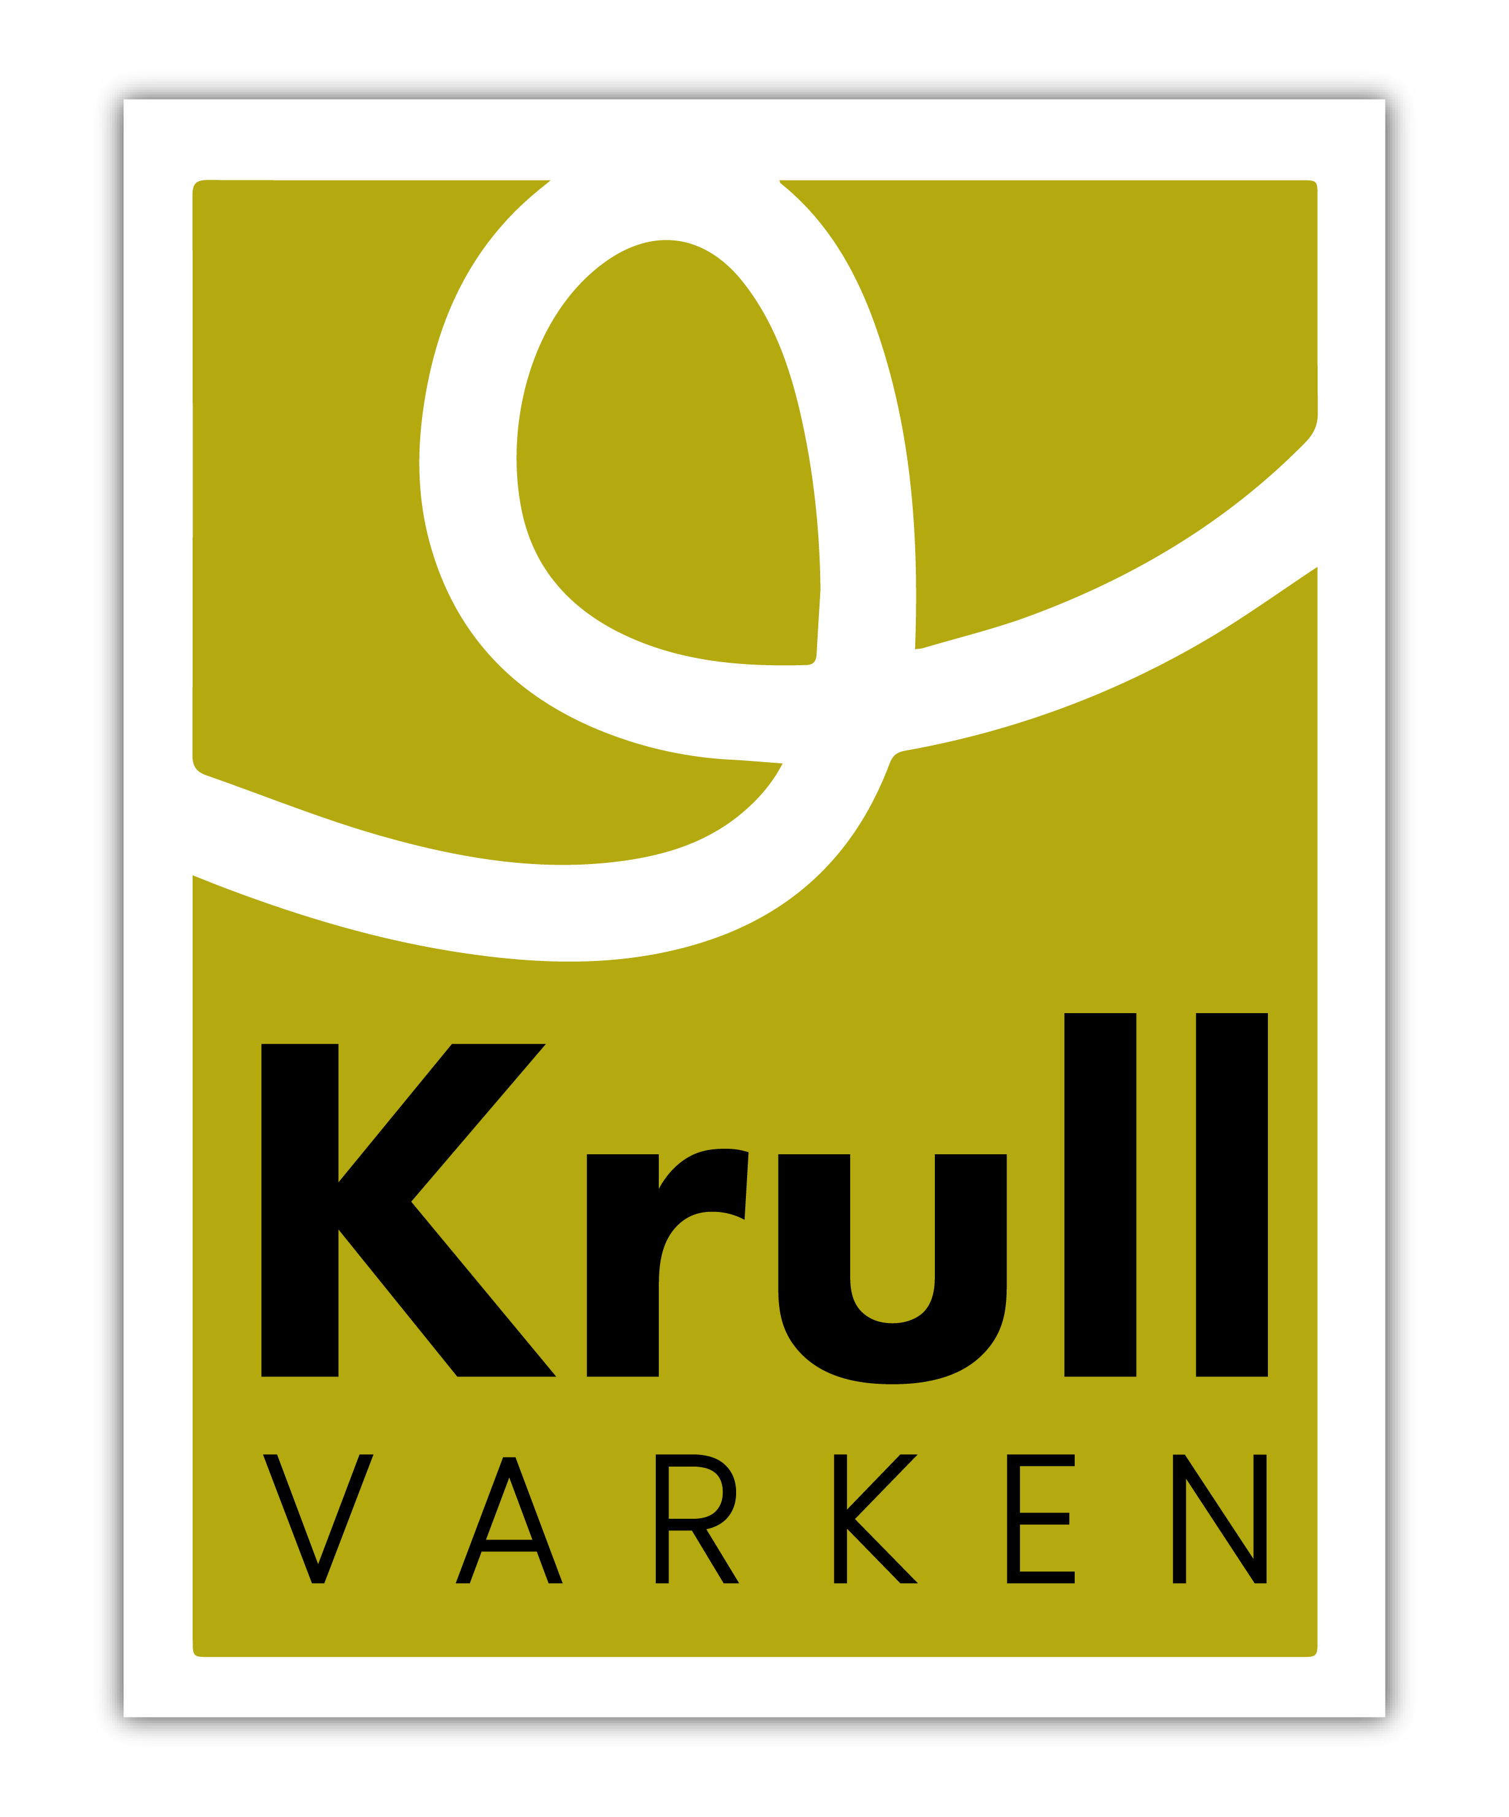
Krull varken
Coen.vanwagenberg@wur.nl
Wageningen Economic Research
7 March 2024

Slide 2
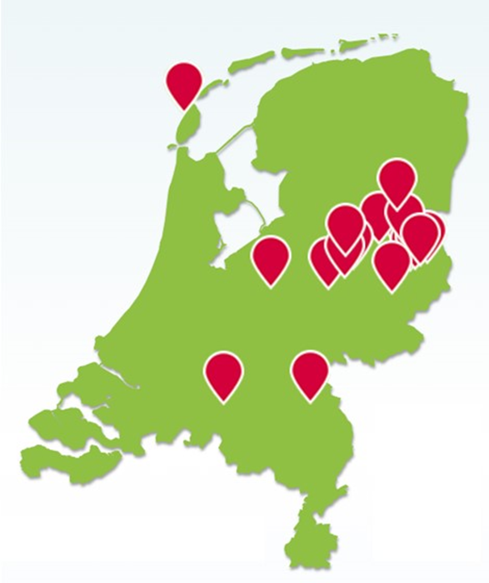
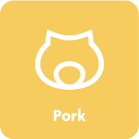
Introduction Krull varken
Krull varken (Krull pigs)
Practice hub 8
Conventional pig production with innovative flooring and biodiversity focus
Type: Pork
NETHERLANDS
Industry partner Wageningen Economic Research
Facilitator Wageningen Economic Research

Slide 3
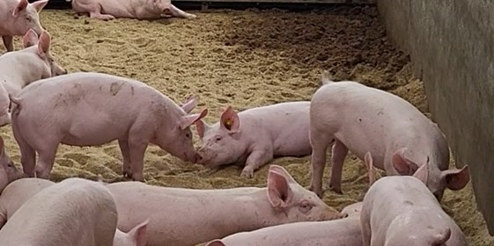
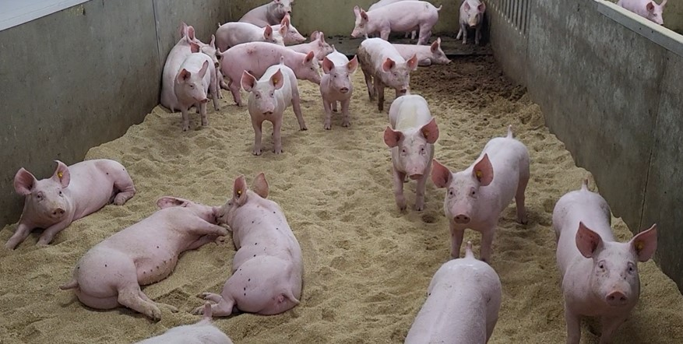
Innovation
OECD Area of Innovation: Production techniques
System type: Intensive, niche
Innovation interests:
Innovative housing system
Only solid floor with a thick layer of bedding material to root, rest and play
Larger groups and more space per animal to enable better social contact between pigs
Natural light rhythm due to many windows
Short supply chain with sales through specialty butchers
Extra attention for biodiversity
Solid manure is better for soil quality and soil life
Flower meadows, flowers in field border, adapted mowing policy, nesting places for birds, hedge banks

Slide 4
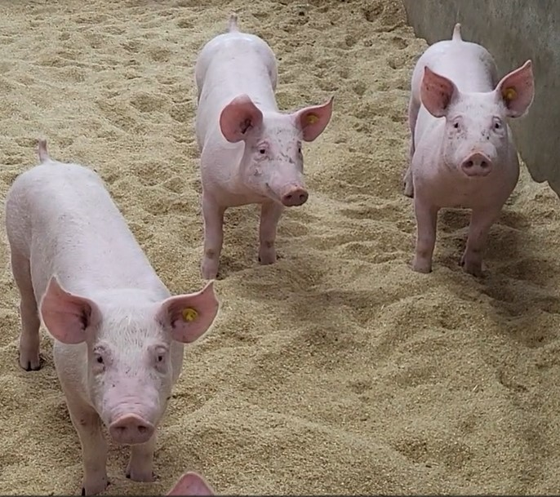
Challenges
Major challenges of Krull varken are related to the market:
How to improve the market for finishing pigs from the Krull pigs concept?
How to better utilize and get more value from the solid manure?

Slide 5
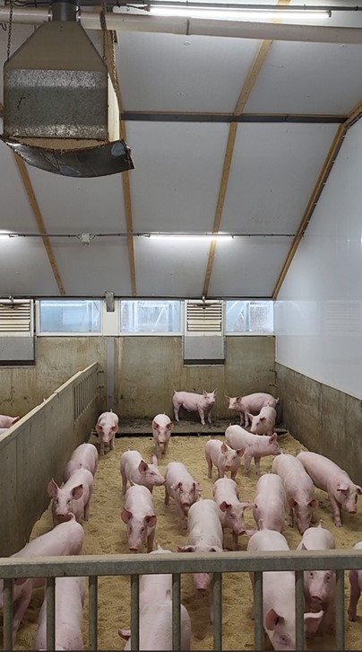
Uniqueness
Krull varken is a unique more sustainable concept in the Dutch pig sector, which could be seen as an example of pig husbandry of the future.
It requires sustainability measures and effort beyond legal requirements and results in costs.
For this concept to be viable in the long term, a sound market is needed.
In this living lab we aim to identify aspects to develop such as market for the pigs.

Slide 6
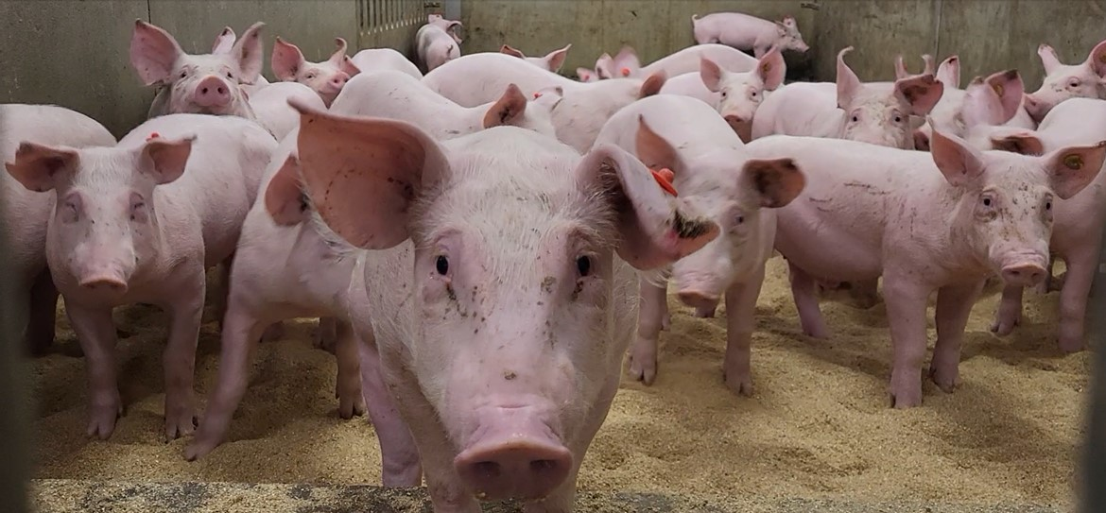
The now and the future
Living Lab proposal sent in for the February 24 round
Perform Living Lab in next year

